Slide 1

Capstone Project
Josh Bazzano
Megan Eunpu

Slide 2

Executive Summary
This project is an automated trading bot that works on the Polygon Blockchain.
Utilizes aspects of Python automation and trading with cryptocurrencies via Metamask wallet

Slide 3
The Approach
LIVE DEMO
Notes:
Relevant Code / Screen Shot / Demo

Slide 4

The Approach – Techniques Used
Read API documentation
Inspect the website’s front end and feed request URLs into ChatGPT
Build me a small script in Python that will perform a GET request for this URL
Compare API data to Polyscan block explorer data to cross-reference internal data feed with public blockchain data
Evaluate if trades coming through the wallet monitor were correct
Test if able to make trades out of personal wallet via Python scrips (yes)
Get scaffolding code, get it to work, clean it up, move it to a function holder file called nice_funcs, and import around the project, where necessary
Notes:
Relevant Code / Screen Shot / Demo

Slide 5
Approach - Insights
API didn’t have the information needed
Inspected the front end, found a non-public API which had no credentialing, pinged that, received that data needed
Problem setting allowances and creating correct API keys
Joined Polymarket Discord channel and worked with other developers to trouble shoot. Able to resolve
Throw out junk trades or trades where the user was taking profit or selling at loss in an existing position
Created trade filter by USD size and existing position ROI
Notes:
If selling and already at a loss, don’t trade
If selling and already at a profit, don’t trade
If buying and already at a loss, don’t trade
If trade size is less than $X, don’t trade
If buying and already at profit, TRADE

Slide 6
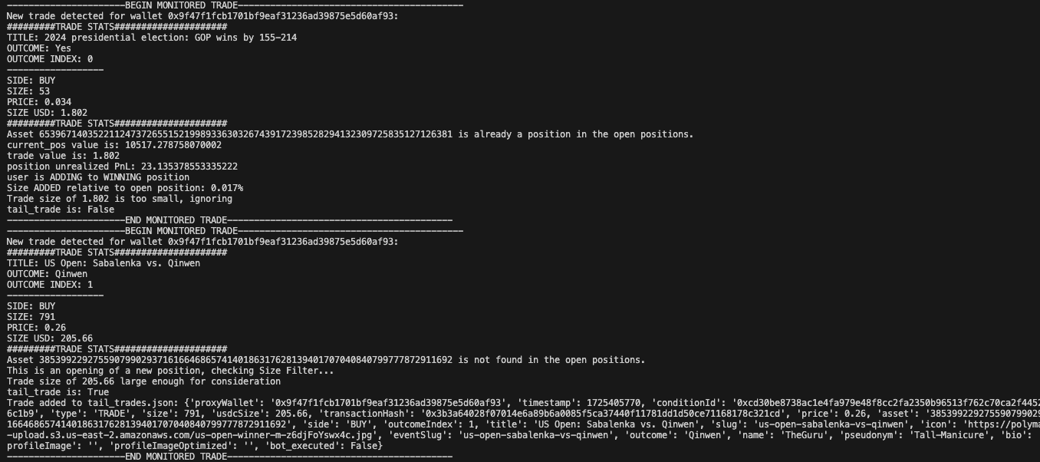
Results – Script #1 Wallet and Trade Monitor Bot

Slide 7
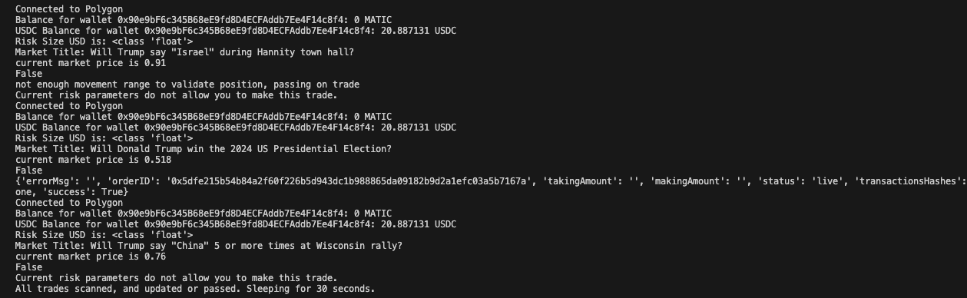
Results – Script #2: Trade Execution Bot

Slide 8
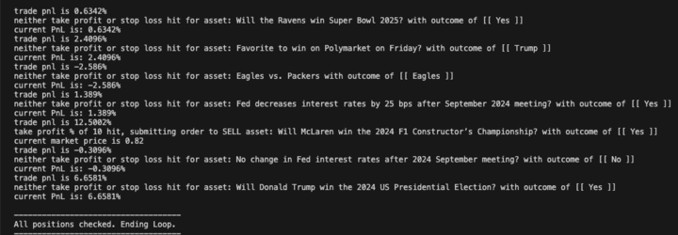
Results: Script #3: Risk Management Bot

Slide 9
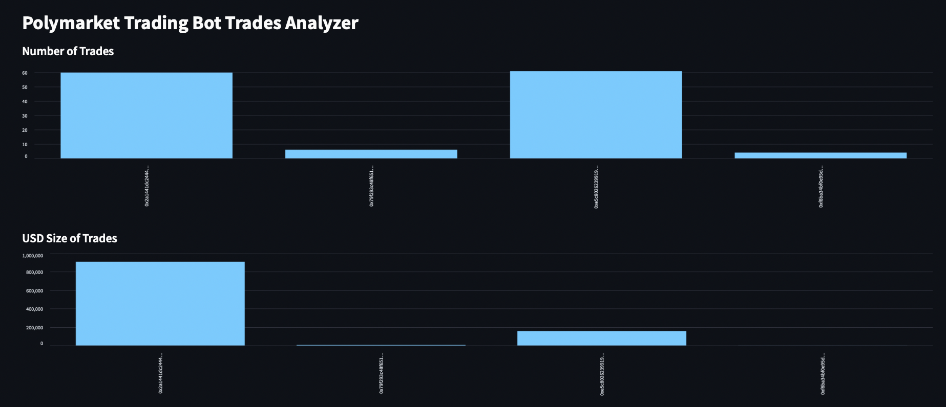
Results – Streamlit Frontend: Monitored Trade Visualizations

Slide 10
Next Steps
Potential Next Steps
Building in more robust risk management framework
Additional questions to explore
Building the monitor not in an internal API, but on public blockchain data. The company could shut off access to internal API which would disconnect the wallet monitor. Following the transaction on the the chain would provide a completely decentralized avenue for running the bot.

